Slide 1
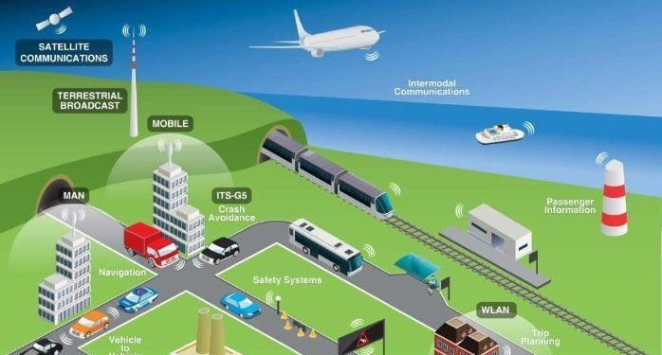
Smart transportation system using ibm watson

Slide 2
Project description:
Automated fleet management solutions helps to connect vehicles and monitor driver activities, managers gain an unprecedented level of insight into fleet performance and driver behavior. This enables them to know where vehicles and drivers are at all times, identify potential problems much sooner and mitigate risks before they become larger issues which can impact client satisfaction, impact driver safety or increase costs. The authorities can track their vehicles along with the time. They can even track different data like when the vehicle has started from one particular location and when it reached its destination by considering the time and gps coordinates.

Slide 3
PROJECT HIGHLIGHTS
Working with IBM Watson cloud services
Accessing Sensor data from anywhere in the world.
Tracking of Vehicle Location is made much easier for the customer as well as the delivery authority.
Improves Client Satisfaction, Driver safety .

Slide 4
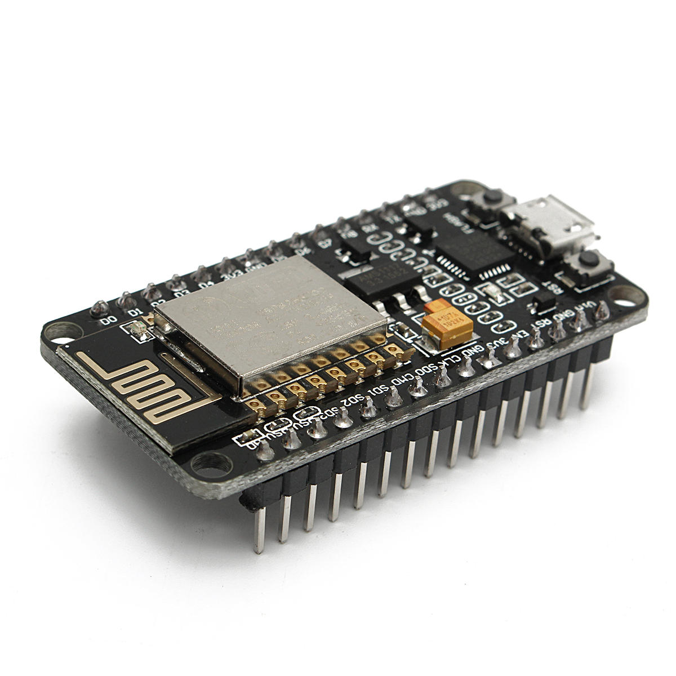
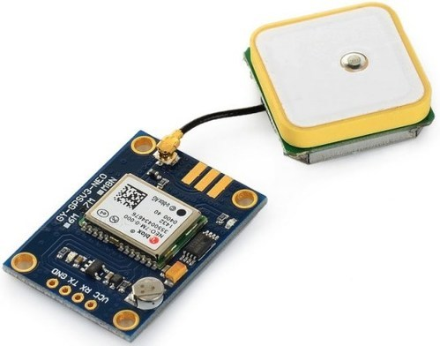
Components required:
NODEMCU-ESP8266
GPS MODULE:
uBlox NEO-6M

Slide 5
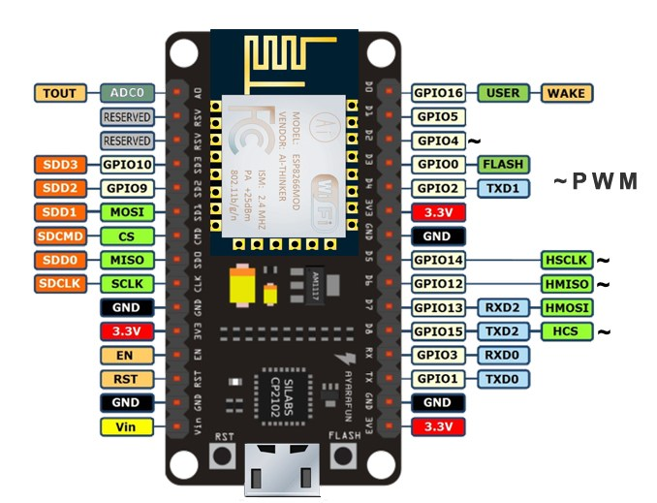
Nodemcu:
It consists of 13 GPIO pins(General Purpose Input andOutput)
This board is 32 bit MCU
Flash memory of 4MB
SRAM of 128KB
Crystal oscillator clock frequency of 80MHz
ADC0 is an analog pin
13 GPIO pins are digital
D2,D5,D6,D8 are analog output/PWM pins
It has reset and enable pins

Slide 6
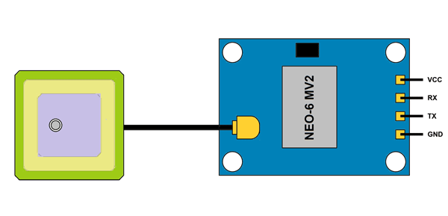
GPS MODULE:
This module has an external antenna and built in EEPROM
Interface:RS232 TTL
Power supply:3V to 5V
Default baudrate:9600bps
Works with standard NMEA sentences
It is also compatible with other micro controller boards

Slide 7
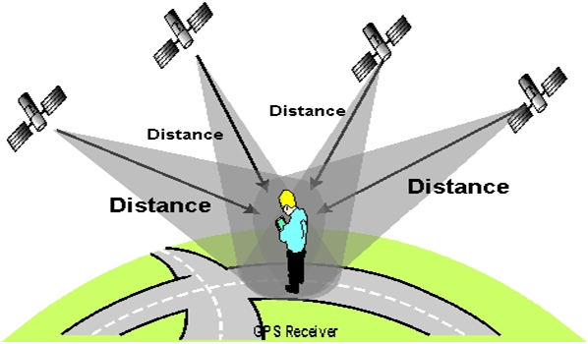
Basic principle of GPS:
The working/operation of Global positioning system is based on the ‘trilateration’ mathematical principle.
The position is determined from the distance measurements to satellites. From the figure, the four satellites are used to determine the position of the receiver on the earth.
The target location is confirmed by the 4th satellite. And three satellites are used to trace the location place. A fourth satellite is used to confirm the target location of each of those space vehicles.
Global positioning system consists of satellite, control station and monitor station and receiver. The GPS receiver takes the information from the satellite and uses the method of triangulation to determine a user’s exact position.

Slide 8
BLOCK DIAGRAM

Slide 9
IBM
CLOUD
WIFI
NODERED
FLOW
NODE
MCU
GPS MODULE
ARDUINO
WORLD MAP

Slide 10
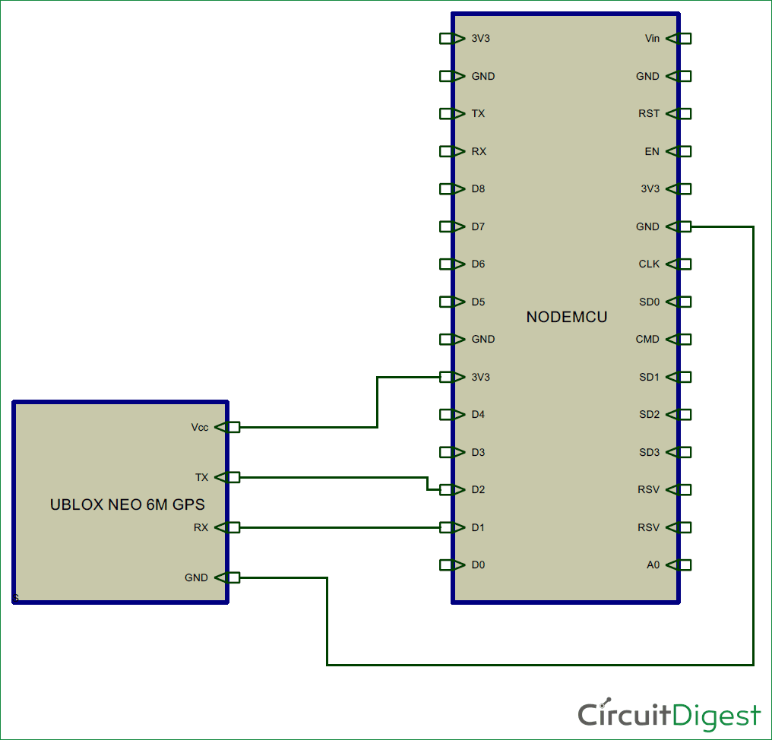
GPS MODULEWIRING TO NODE MCU:
GPS module | Wiring to NODE MCU
VCC | 5V
RX | TX pin defined in the software serial
TX | RX pin defined in the software serial
GND | GND

Slide 11
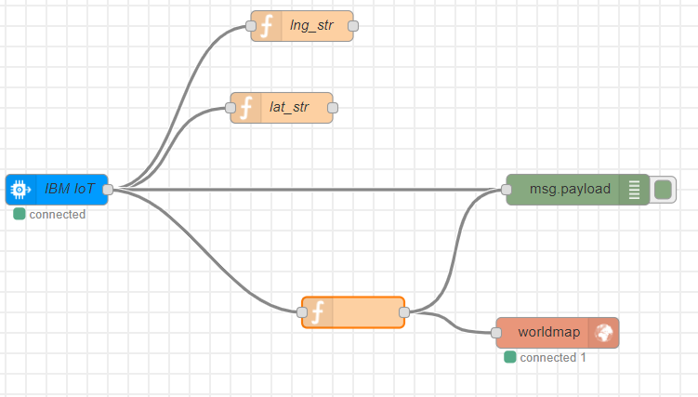
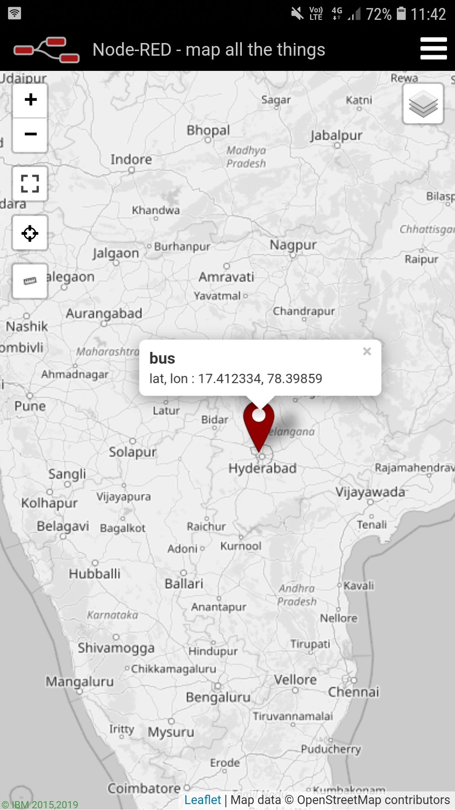
NODE RED CONNECTIONS OUTPUT

Slide 12
Advantages:
Improves customer service.
Ensuring the safety of drivers.
Improving the productivity.
Reduces the fuel consumption.
Reduces the loss of vehicles.

Slide 13

PROJECT DONE BY:
T. Sai Manasa
A. Sai Ishwarya
K. Bindhu Madhavi
J. Madhu Priya

